Slide 1
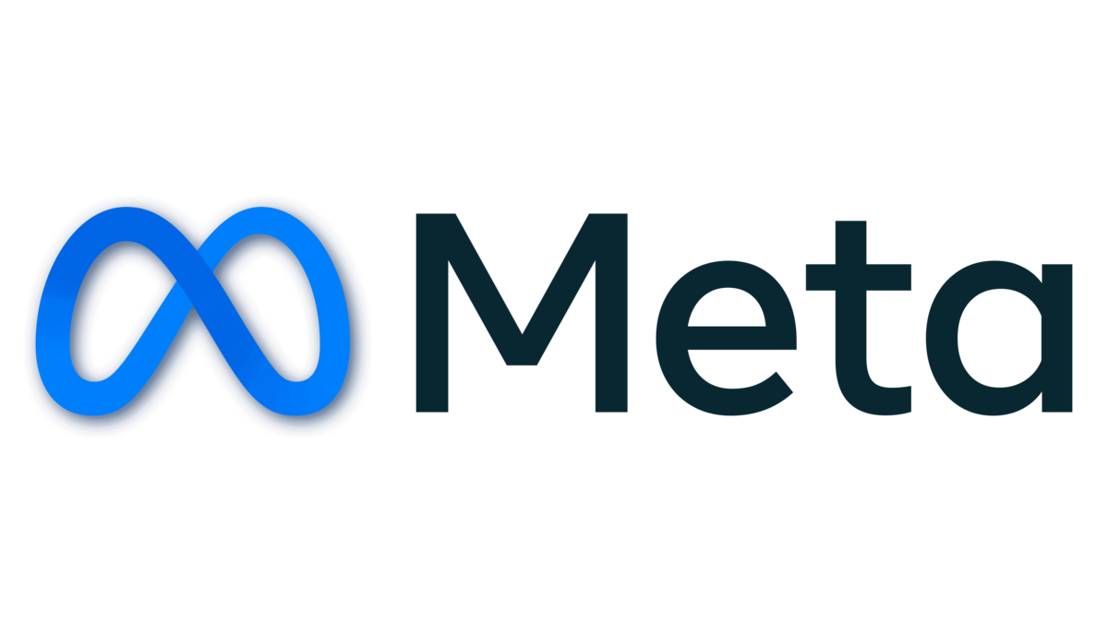
SOCIAL MEDIA ANALYSIS
Presented by: Nidhi Roy | Date: 14 Sep 2025

Slide 2
Table of Content
About Meta
Problem Statement
Design Schema
Data Overview
Approach
User Engagement Distribution
User Activity
Hashtags vs Engagement
Recommendation
Conclusion

Slide 3



About Meta
Meta, formerly known as Facebook, is a technology company founded by Mark Zuckerberg in 2004. It rebranded to Meta in October 2021 to emphasize its focus on building the "metaverse," a virtual reality space where users can interact in a shared, immersive environment. Meta's ecosystem includes social media platforms like Facebook, Instagram, and WhatsApp, as well as technologies for augmented and virtual reality, such as Oculus. The company's vision is to create a new digital frontier where people can connect, work, and play in virtual worlds that blend seamlessly with the physical world.

Slide 4

Problem Statement
You are hired as a data analyst at Meta and asked to collaborate with the Marketing team. Marketing teams want to leverage Instagram's user data to develop targeted marketing strategies that will increase user engagement, retention, and acquisition. Provide insights and recommendations to address the following objectives.

Slide 5
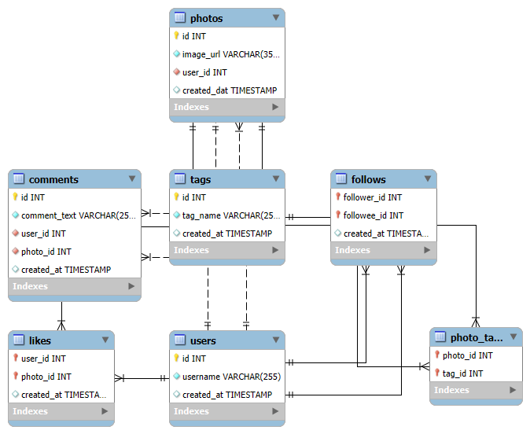
Design Schema
Total 7 Tables are present in the given dataset.
Tables in dataset- users, comments, likes, photos, photo_tags, tags, follows.
Total number users are 100.
Total number of posts made so far is 257.
Total number of likes posted by the users on posts is 8782.
Total number of comments on all posts are 7488.

Slide 6
Data Overview
comments_id : unique identifier for each comment
comment_text : text content of a given comment
user_id : unique identifier for each user
photo_id : unique identifier for each photo
created_at : date of interaction in the form like, photos, tags
follower_id : user_id of the follower for a certain user
followee_id : user_id of followee for a certain user
tag_id : unique identifier for each tag
image_url : link to the image posted on the platform
username : username chosen by the user

Slide 7

Approach
Problem Definition
Clearly defined the problem statement by outlining the key business questions, analytical objectives, and expected outcomes. Assessed the available data sources to confirm their alignment with the analysis goals.
Data Preparation and Cleaning
Performed comprehensive data cleaning by identifying and removing duplicate entries, resolving missing values, and correcting inconsistencies to ensure data accuracy, completeness, and reliability.
Analytical Approach
Utilized advanced SQL methodologies—including CTEs, aggregate functions, subqueries, GROUP BY clauses, and ranking functions—to perform in-depth analysis, uncover patterns, and generate actionable insights.

Slide 8
Approach
Data Visualization
Developed insightful visual dashboards using charts and graphs to represent key performance metrics such as total posts, likes, and comments. These visualizations enabled ranking users by engagement levels and identifying the most impactful hashtags.
Strategy Development
Devised data-driven strategies to enhance user engagement and retention. Proposed targeted initiatives and interactive approaches to foster stronger user participation and overall platform growth.
Implementation and Optimization
Defined clear execution steps for strategy deployment and introduced optimization techniques to continuously refine performance, ensuring sustained engagement and measurable improvements over time.

Slide 9
User Engagement Distribution
Active Users (30%) – Highly engaged users who frequently like, comment, or share posts; ideal for brand advocacy and community growth.
Moderately Active Users (34%) – Moderately engaged users who interact occasionally; potential targets for campaigns to boost engagement.
Inactive Users (36%) – Low or no engagement users; require re-engagement through personalized content or promotional efforts.

Slide 10
User Activity On Photos
The chart illustrates user posting activity.
Out of 100 users, 26 haven’t posted, while 18 have shared only once—the second-largest group.
Few users (1–2) post more than six times, with just one reaching 12 posts.
Overall, posting frequency declines as post count rises, indicating low user activity and the need to encourage more content sharing.

Slide 11
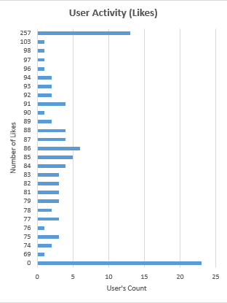
User Activity On Likes
The chart highlights user engagement through likes.
Around 22 users haven’t given any likes, showing low interaction levels.
Most users gave between 75–95 likes, though sparsely distributed, while one user stood out with 257 likes.
Overall, engagement is minimal, suggesting a need to encourage more users to actively like and interact with content.

Slide 12
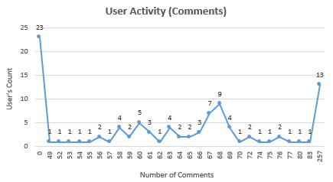
User Activity On Comments
The chart illustrates user interaction through comments.
About 23 users haven’t commented at all, showing low engagement.
Most users made only 1–2 comments, while a small group posted 7–9 comments.
A few outliers, like 13 users with 257 comments, show high activity.
Overall, commenting is limited, with only a small portion of users actively participating.

Slide 13
Hashtags vs Engagement
The chart shows consistent engagement across all hashtags, ranging from 63–65.
Beauty, delicious, and foodie lead with the highest engagement at 65, while hashtags like dreamy, food, photography, smile, stunning, and sunset follow closely at 64.
Beach records slightly lower engagement at 63 but remains comparable.
Overall, users show strong interest in lifestyle, food, and visual themes—insights that can guide targeted content and campaigns to enhance engagement.

Slide 14

User Retention
Re-Engagement Campaigns
Recommend personalized posts, hashtags, and user accounts based on previous activity to encourage users to reconnect with the platform.
Exclusive Incentives
Provide time-limited discounts on premium features to motivate users to return and re-engage.
Content Discovery Tools
Develop short tutorials showcasing new features and trending content to help users explore the platform with ease.
Feedback and Surveys
Distribute quick surveys to inactive users to identify reasons for disengagement, offering incentives to gather valuable insights for improving retention.

Slide 15

User Acquisition
Personalized Onboarding
Create a customized onboarding flow for new users, showcasing key features, trending hashtags, and success stories to enhance initial engagement.
Hashtag Education Campaigns
Introduce blog posts and video tutorials to educate users on effective tag usage and its impact on visibility and engagement.
Referral Rewards
Implement a referral program offering discounts or exclusive content to users who successfully invite new members.
Engagement Enhancers
Send tailored emails featuring new features, trending topics, and helpful tutorials to keep users active and engaged.

Slide 16

User Engagement
User Recognition Programs
Launch initiatives like “User of the Month” and photo contests to celebrate active users and drive higher engagement.
Learning Resources
Provide tutorials, guides, and webinars to help users optimize engagement and fully utilize platform features.
Community Building
Establish forums, host virtual events, and introduce an ambassador program to foster collaboration and strengthen the user community.
Influencer Partnerships
Collaborate with key influencers to expand reach, attract new users, and encourage active participation among existing members.

Slide 17

Conclusion
User Acquisition
Utilize influencer collaborations and ambassador programs to bring in new users, complemented by educational resources to help them engage effectively with the platform.
User Retention
Implement personalized content suggestions, exclusive offers, and feedback channels to maintain user interest and reduce inactivity.
User Engagement
Drive engagement through re-engagement campaigns, hashtag promotion, and community-focused activities to motivate inactive and moderately active users to participate more actively.

Slide 18

THANK YOU

